Slide 1
P63. Study of the Treating FTO Electrode with TiCl₄ Q. Wang, X. J. Yin Advanced Material Research Centre, Singapore Polytechnic, Singapore (139651) Correspondence: yinxj@sp.edu.sg; wangqin@sp.edu.sg
Abstract:
Treating FTO electrodes with TiCl₄ is one of the ways to form a TiO2 blocking layer on the surface of FTO electrodes, which is for reducing the electron recombination on the surface of FTO electrode of DSSC. However, our experiment result shows that the effectiveness of this approach to the improvement of the performance of DSSC is doubtful.
The study started from the investigation of the contact resistance between the silver layer and the FTO layer with and without the TiCl4 treatment. The experiment is described in below. And the experiment result shows that the existence of the TiO2 blocking layer formed by TiCl4 treatment will not affect the resistance.
The explanation to the experiment result is revealed in the comparison between the AFM image of TiCl4 treated and un-treated FTO surface as shown in Figure 2. It is shown that the TiCl4 treatment grows many “whiskers” on FTO crystal grain boundary rather than forming an uniform layer on the surface of FTO.
Fifth Aseanian Conference on Dye-sensitized and Organic Solar Cell , August 25-28, 2010, Huangshan, China Page1/2

Slide 2
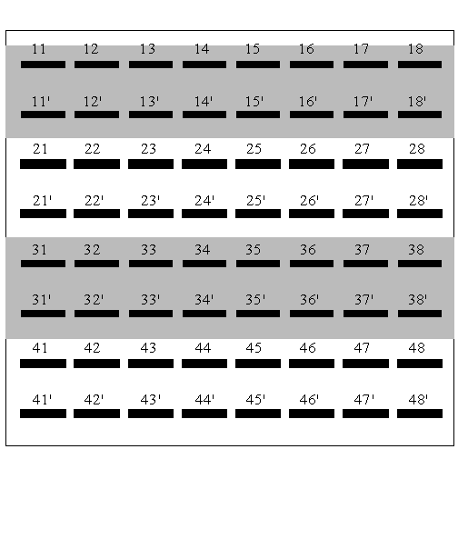
Experiments
As shown in Fig. 1, the grey colour areas in the 100mmx100mm FTO glass substrate are treated by TiCl4. Silver patterns (represented by black squares) are screen printed and numerically labelled. R_{mn} represents the resistance measured between the silver patterns labelled by mn and mn’, and their values are listed in Table 1 corresponding to their positions. With the data at the edge of the substrate not being counted due to the edge effect, it can be obtained that the difference between the average resistance in TiCl4 treated and un-treated area is less than 0.4%. (As all these resistance were measured by the same digital multi-meter, the system error of the multi-meter will not affect the result.) Thus, it is reasonable to draw the conclusion that the treatment of TiCl4 will not affect the contact resistance between silver and FTO layer.
Table 1 R_{mn} in corresponding to their positions (unit is ohm).
5.5 | 4.6 | 4.4 | 4.3 | 4.4 | 4.7 | 5.1
5.1 | 4.3 | 4.2 | 4.2 | 4.2 | 4.4 | 4.3
5.1 | 4.3 | 4.2 | 4.2 | 4.2 | 4.2 | 4.4
5.3 | 4.4 | 4.2 | 4.2 | 4.2 | 4.2 | 4.4
Fig. 1 The layout of the TiCl4 treated area
and silver patterns
(a)
(b)
Fig. 2 (a) AFM image of the FTO surface before TiCl₄ treatment; (b)AFM image of the FTO surface after TiCl₄ treatment.
Fifth Aseanian Conference on Dye-sensitized and Organic Solar Cell , August 25-28, 2010, Huangshan, China Page 2/2

